Slide 1
PROGRAM QUAD USER GUIDE
3/18/2019

Slide 2
Pre-System Checks
Recommended Browser Internet Explorer version 9 and above.
Enable Pop-ups in Browser

Slide 3
Contents
Authentication
New Quad
Permissions
Program Collaboration
Program Funding
Program Procurement Quantities
Program Presentations

Slide 4
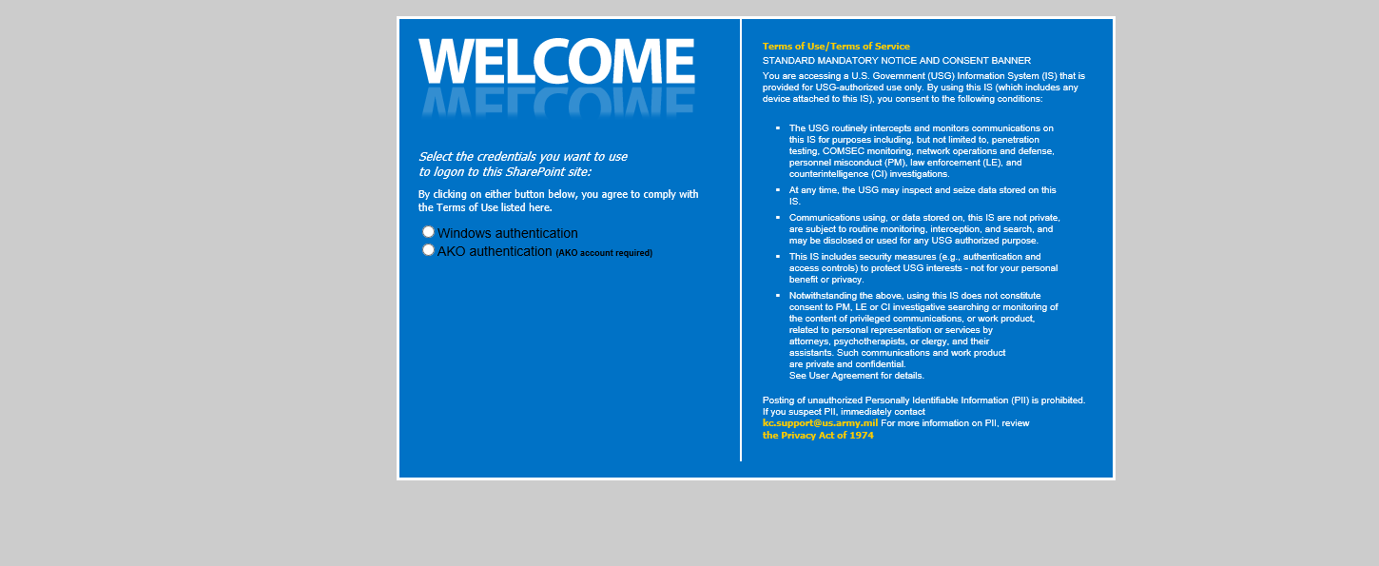
Quad Landing Page
Click AKO Authentication. Use Select appropriate Certificate When Redirected to EAMS Page.

Slide 5
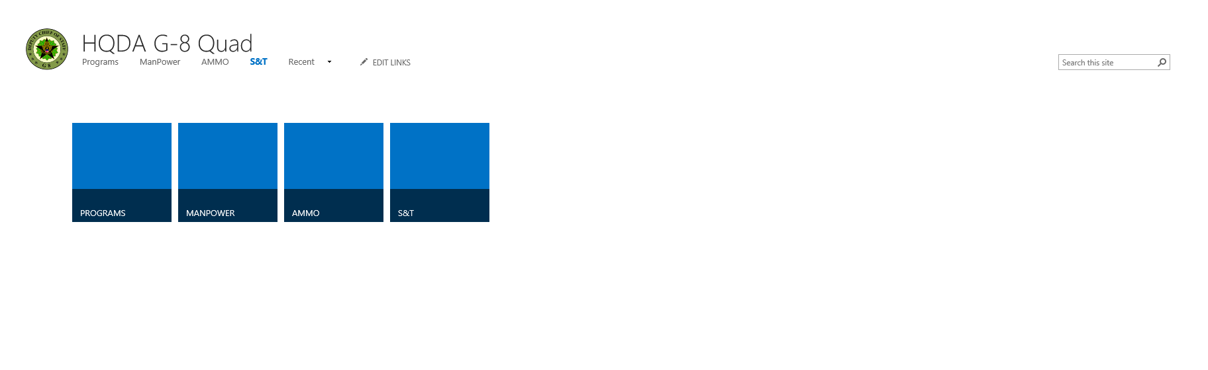
Quad Landing Page
User is directed to Quad Landing Page. Click Programs Button.

Slide 6
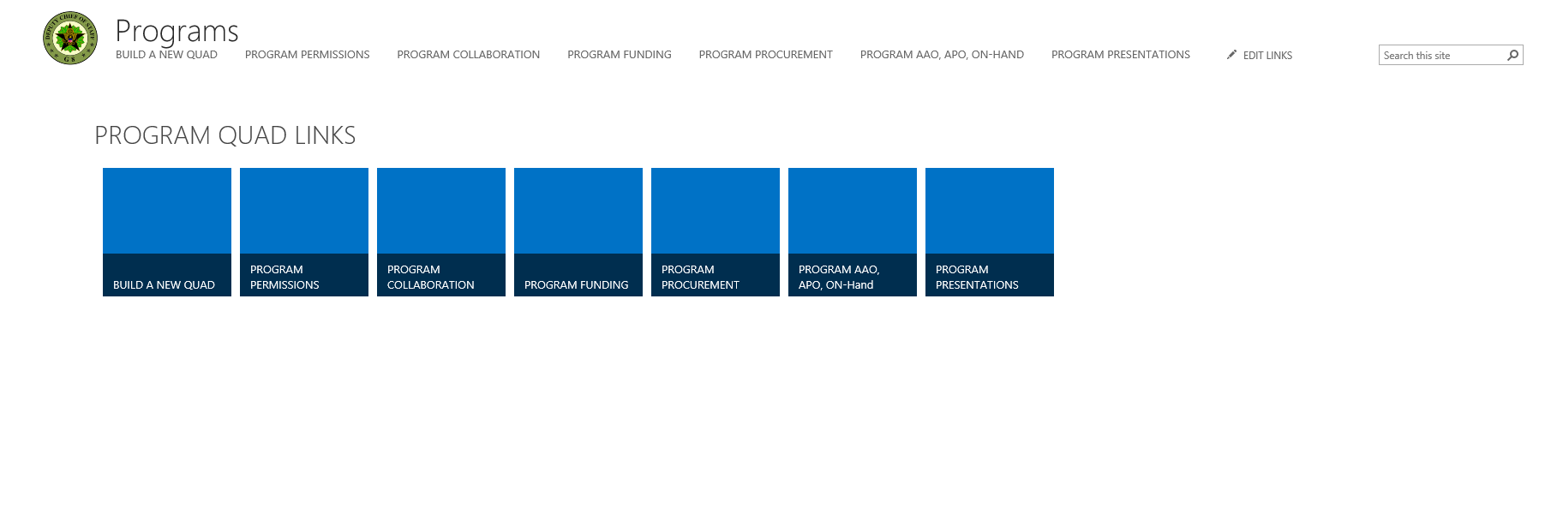
Quad Landing Page
Click ‘BUILD A NEW QUAD’

Slide 7
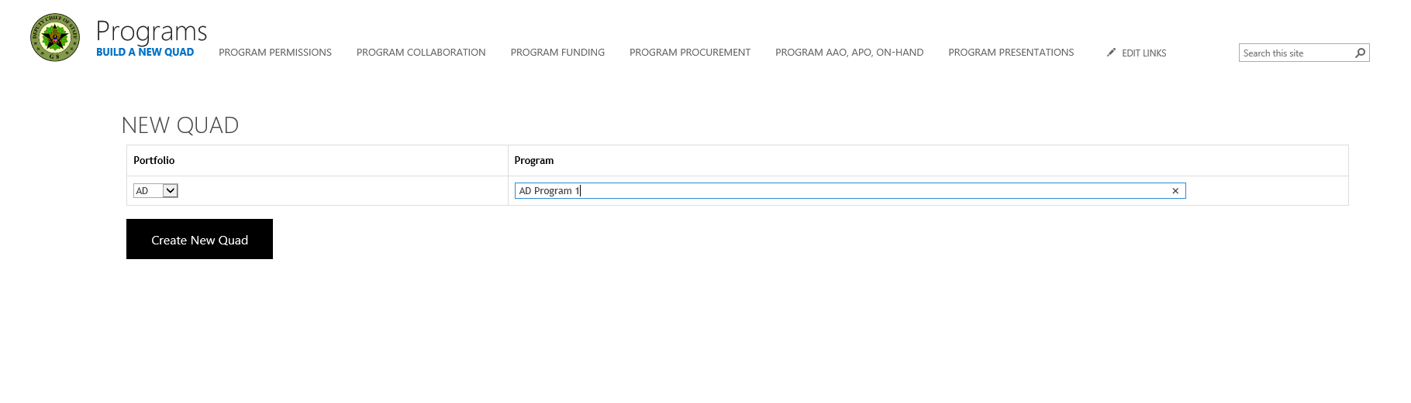
New Program Created
2. Click ‘Create New Quad’ button
1. Enter Program Name

Slide 8
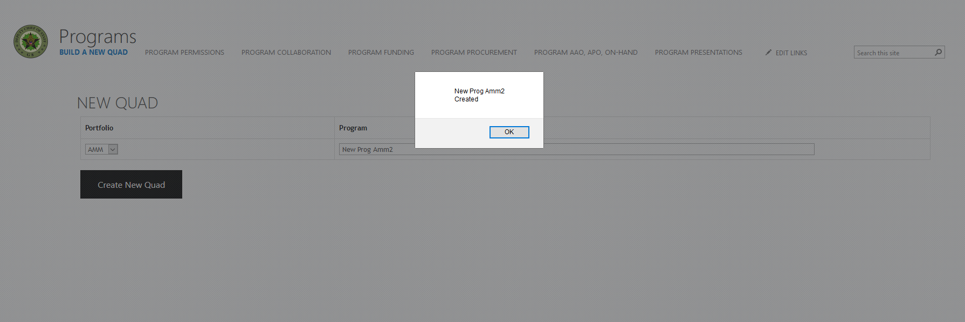
New Program Created
Alert Box Appears When New Program is Created

Slide 9
PERMISSIONS
Click ‘PROGRAM PERMISSIONS’

Slide 10
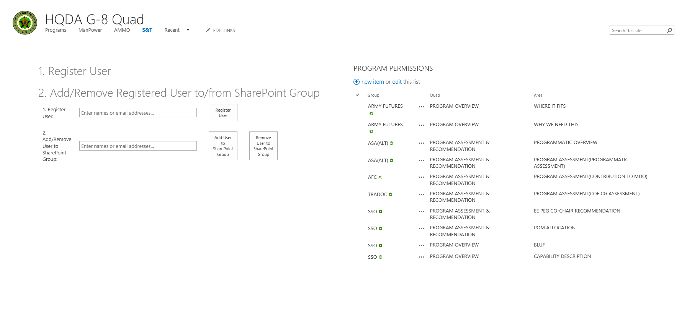
Quad Permissions Group Page
Search for User and Click ‘Register User’ Button

Slide 11
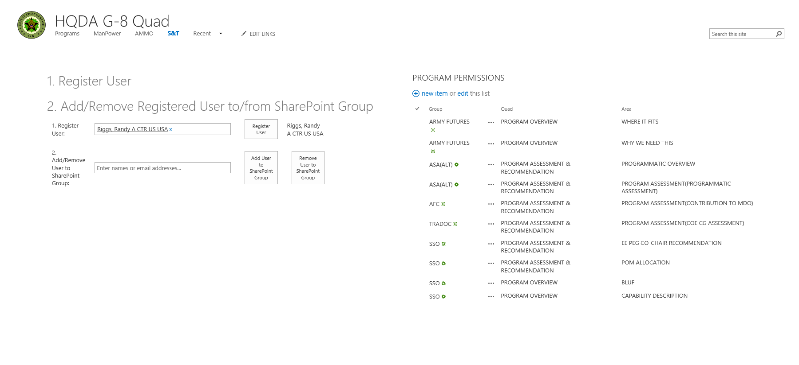
Quad Permissions Group Page
Search for User and Click ‘Register User’ Button

Slide 12
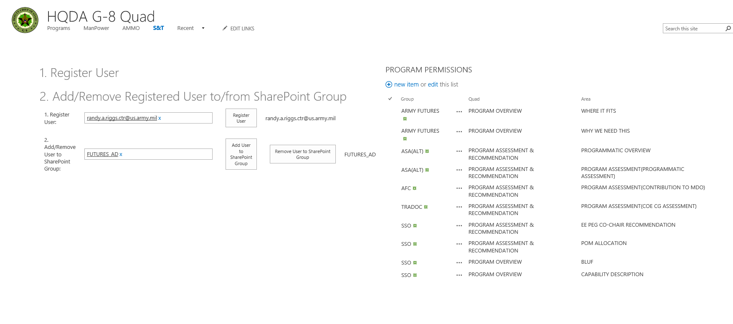
Quad Permissions Group Page
Search for User and Click ‘Add User to SharePoint Group’ Button. You can reference the list to the right.

Slide 13
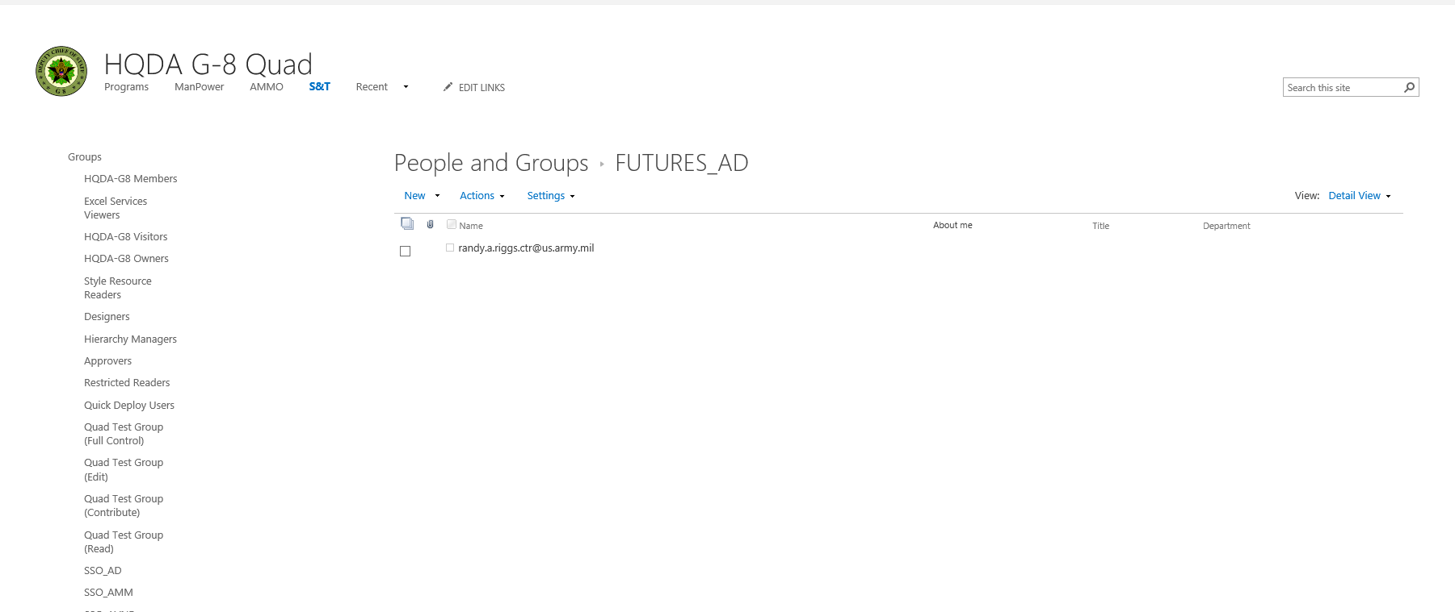
Quad Permissions Group Page
Group Page Opens Confirming User Membership

Slide 14
Quad Permissions Group Page
Click Remove User from SharePoint Group

Slide 15
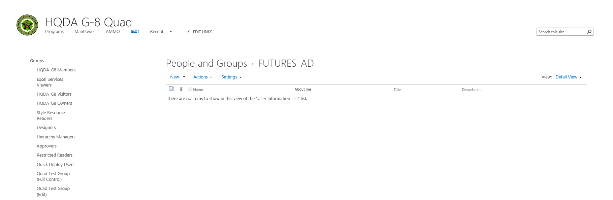
Quad Permissions Group Page
Click Remove User from SharePoint Group

Slide 16
Quad Permissions Group Page
Click Programs

Slide 17
PROGRAM COLLABORATION
Click ‘PROGRAM COLLABORATION’

Slide 18
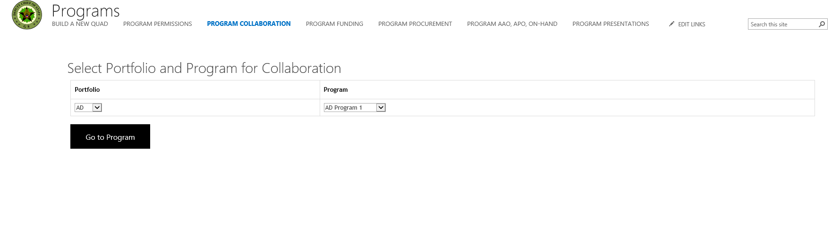
PROGRAM COLLABORATION
Select Portfolio and Program

Slide 19
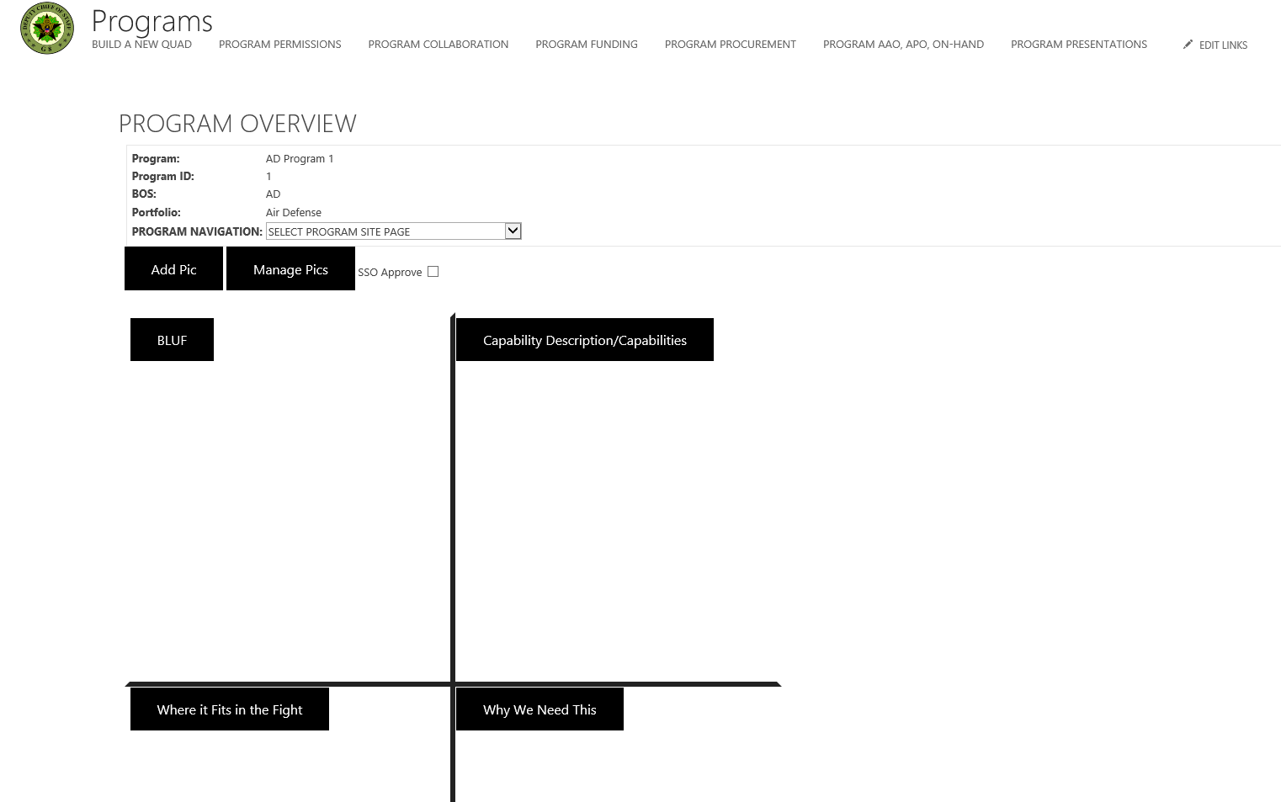
PROGRAM COLLABORATION
Users Redirect to Program Overview

Slide 20
PROGRAM COLLABORATION
Users Redirect to Program Overview

Slide 21
PROGRAM COLLABORATION
Click ‘BLUF’ BUTTON

Slide 22
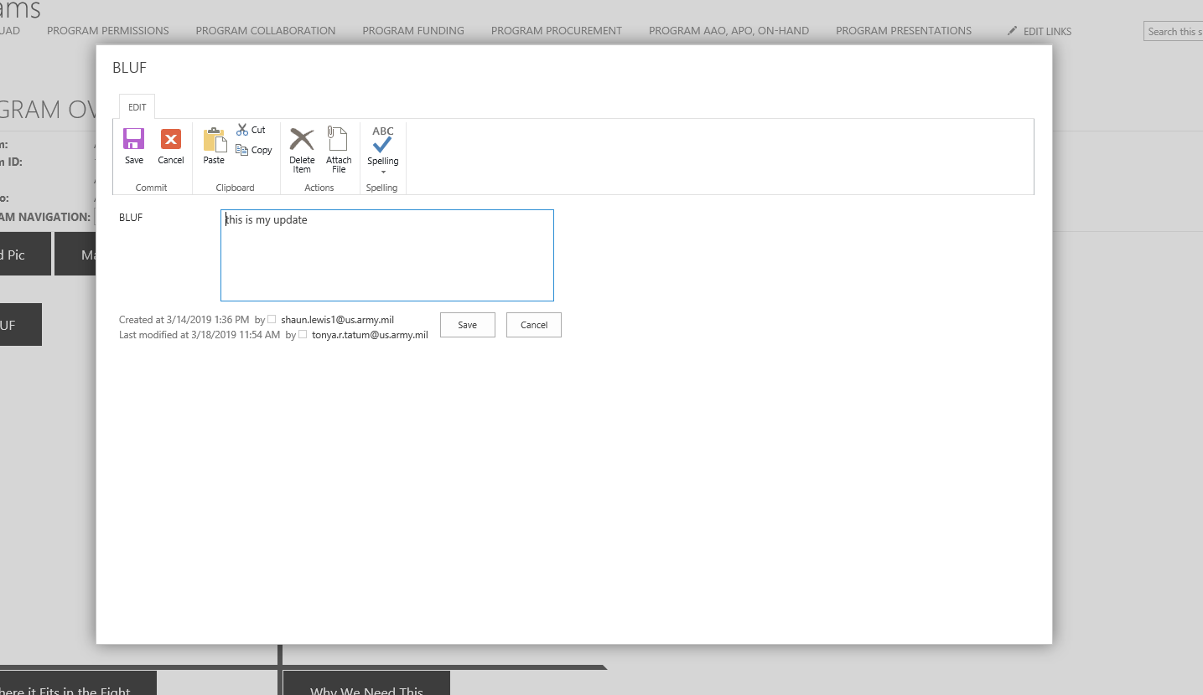
PROGRAM COLLABORATION
BLUF Modal Box Appears. Enter Data and Save. Reopen, Your Saved Data Should Display.

Slide 23
PROGRAM COLLABORATION
Click Capability Description/Capabilities

Slide 24
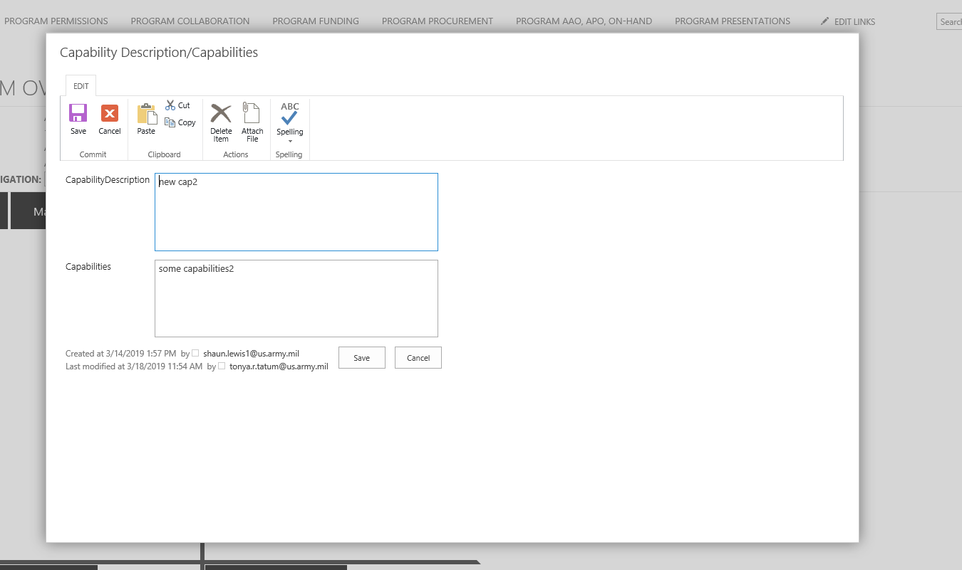
PROGRAM COLLABORATION
Capability Description/Capabilities Modal Box Appears. Enter Data and Save. Reopen, Your Saved Data Should Display.

Slide 25
PROGRAM COLLABORATION
Click Where it Fits in the Fight Button

Slide 26
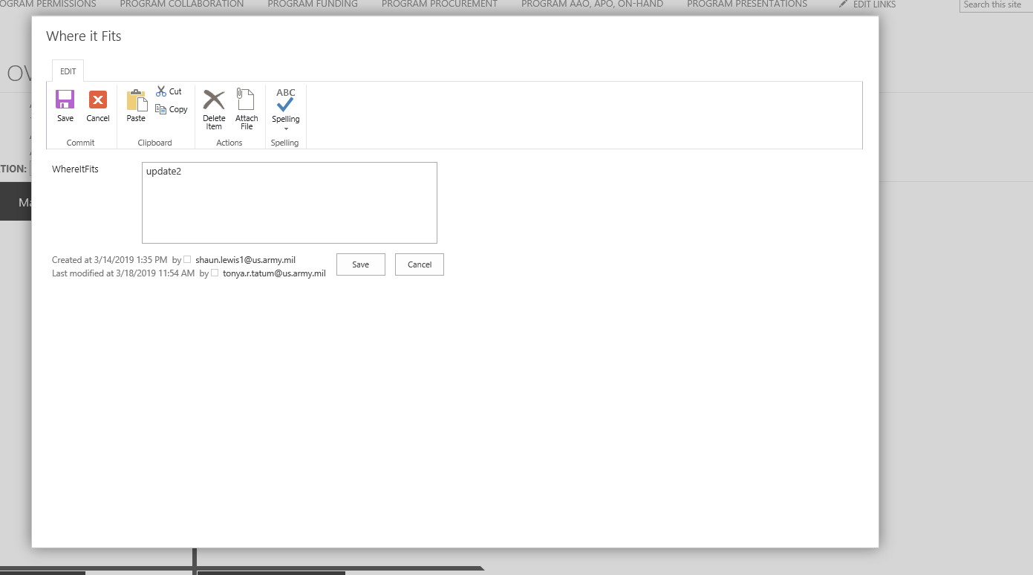
PROGRAM COLLABORATION
Where it Fits in the Fight Button Modal Box Appears. Enter Data and Save. Reopen, Your Saved Data Should Display.

Slide 27
PROGRAM COLLABORATION
Click Why We Need This Button. Why We Need This Button Modal Box Appears. Enter Data and Save. Reopen, Your Saved Data Should Display.

Slide 28
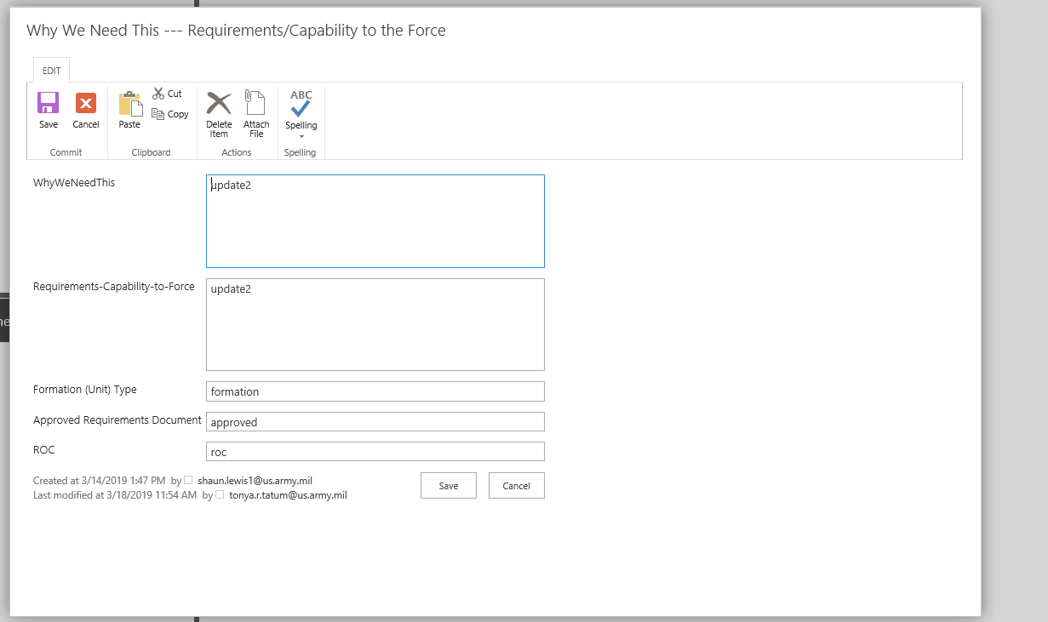
PROGRAM COLLABORATION
Why We Need This Button Modal Box Appears.Enter Data and Save. Reopen, Your Saved Data Should Display.

Slide 29
PROGRAM COLLABORATION
Click Add Pic Button

Slide 30
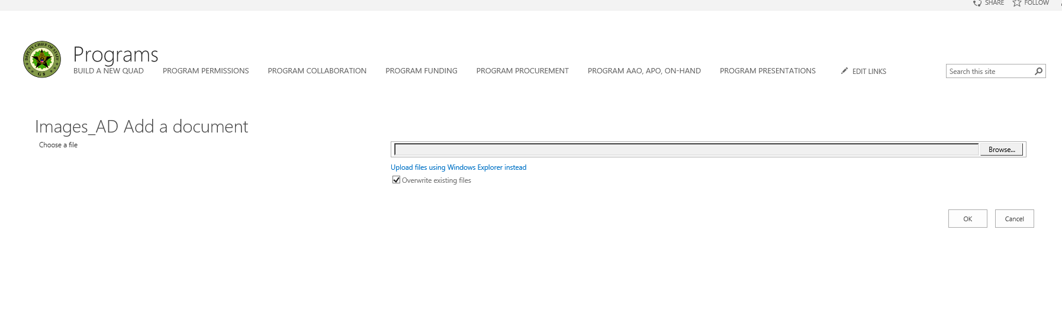
PROGRAM COLLABORATION
Browse and Upload PIC and Click OK

Slide 31
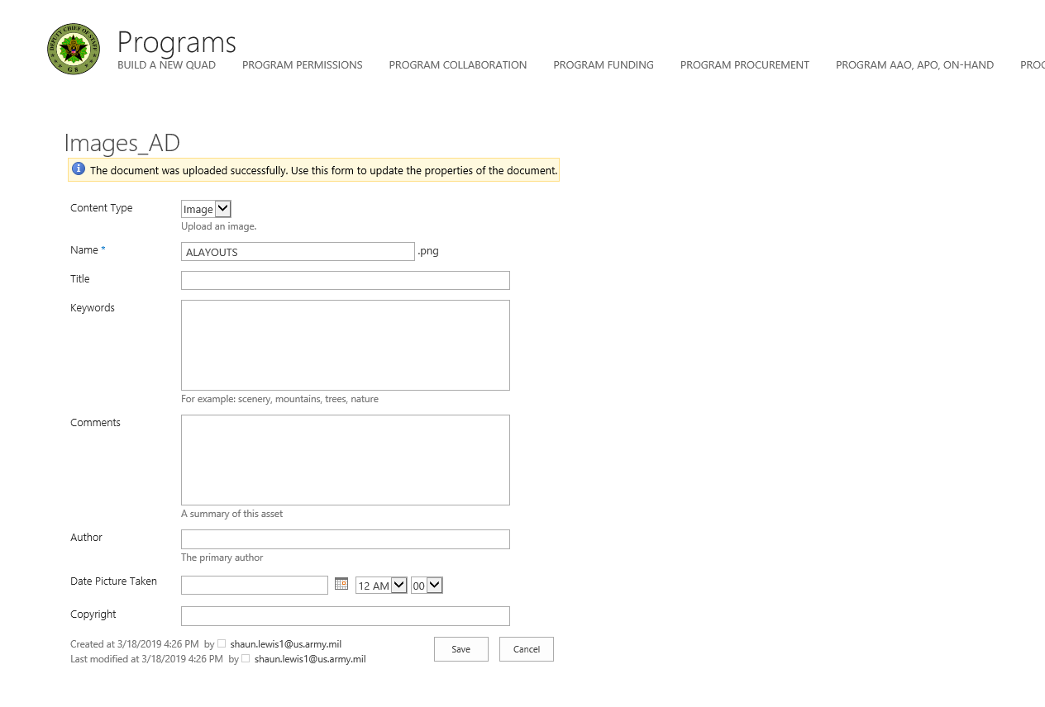
PROGRAM COLLABORATION
Insure Image is displaying for Content Type. You can add optional information for the picture. Click Save.

Slide 32
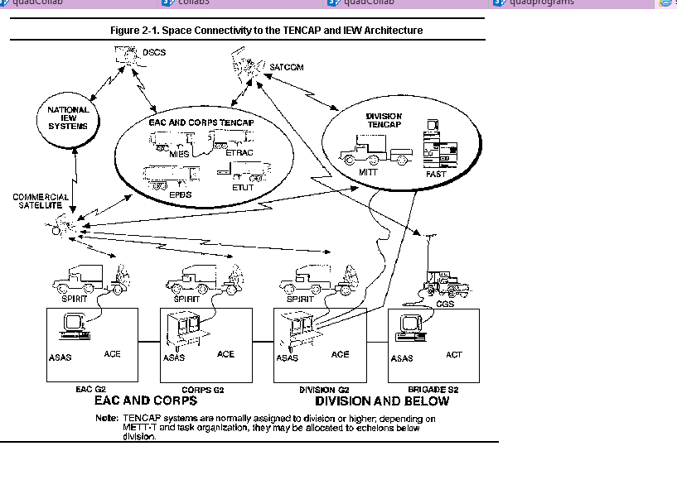
PROGRAM COLLABORATION
Displayed Image

Slide 33
PROGRAM COLLABORATION
Click Manage Pics Button

Slide 34
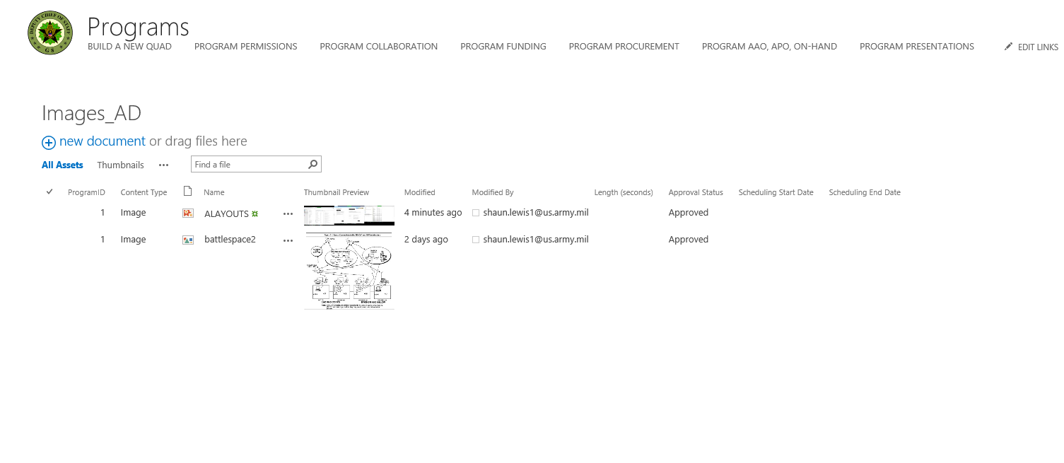
PROGRAM COLLABORATION
Pics are displayed in document library.

Slide 35
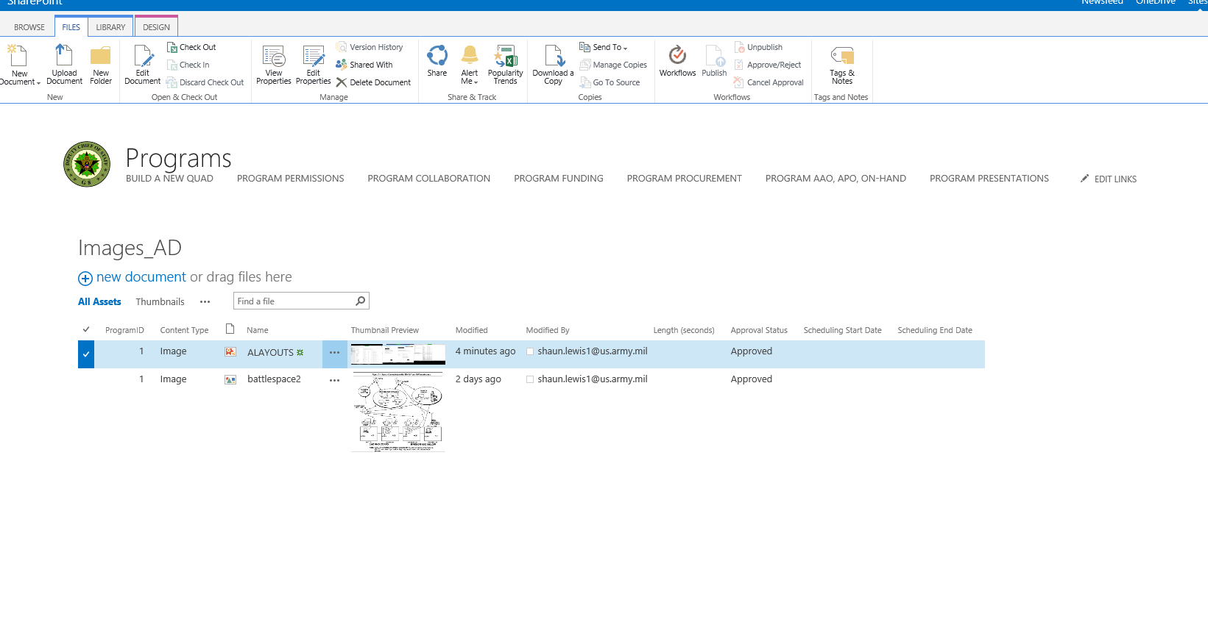
PROGRAM COLLABORATION
Click Check Filter
Click Delete Document

Slide 36
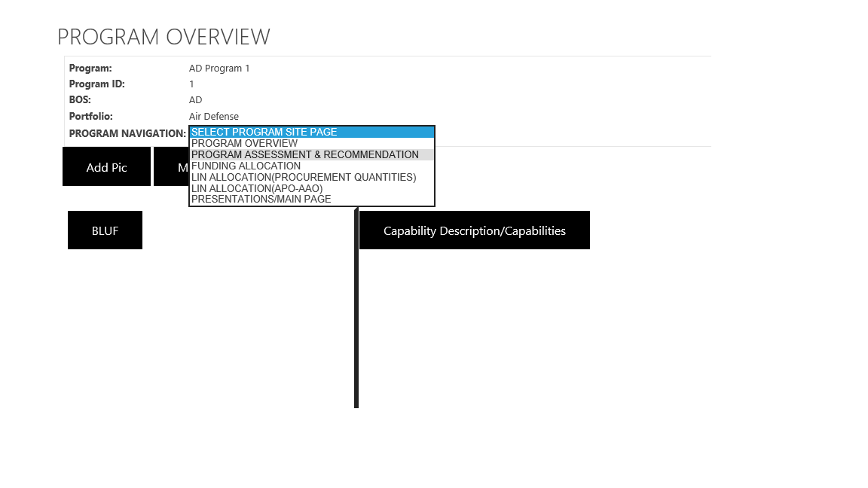
PROGRAM COLLABORATION
Select Program Navigation Drop Down
Select Program Assessment & Recommendation

Slide 37
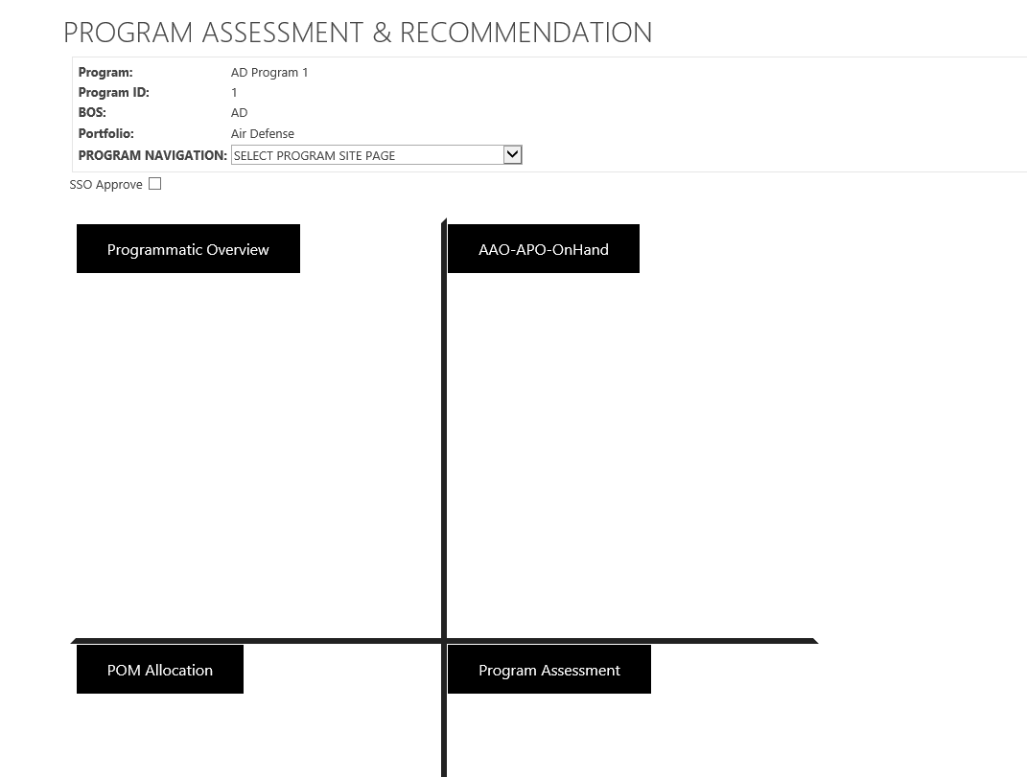
PROGRAM COLLABORATION
Users will be redirected to Program Assessment & Recommendation

Slide 38
PROGRAM COLLABORATION
Click Programmatic Overview

Slide 39
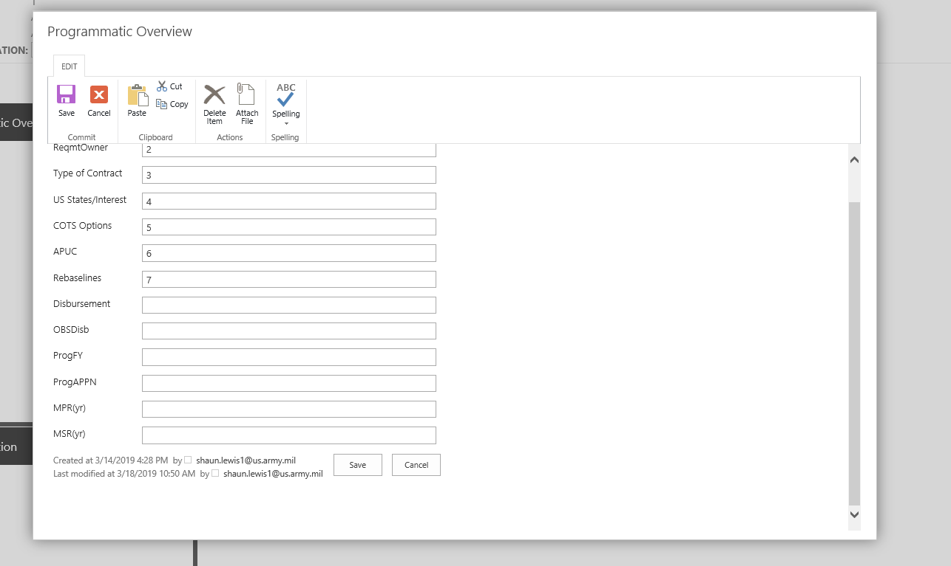
PROGRAM COLLABORATION
Programmatic Overview Button Modal Box Appears. Enter Data and Save. Reopen, Your Saved Data Should Display.

Slide 40
PROGRAM COLLABORATION
Click Program Assessment

Slide 41
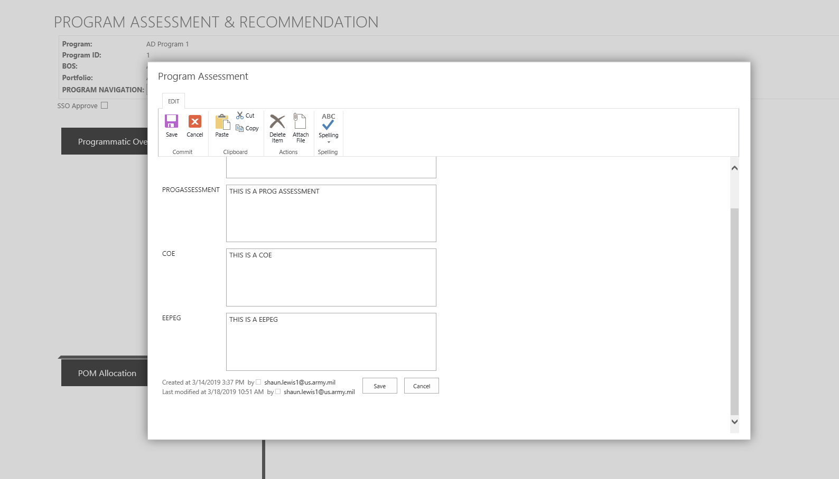
PROGRAM COLLABORATION
Program Assessment Button Modal Box Appears. Enter Data and Save. Reopen, Your Saved Data Should Display.

Slide 42
PROGRAM COLLABORATION
Click AAO-APO-OnHand

Slide 43
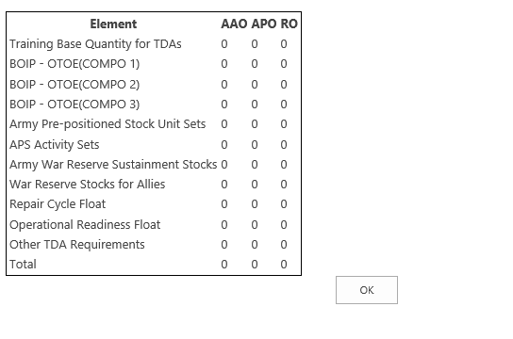
PROGRAM COLLABORATION
AAO-APO Modal Box Appears. Note: RO will change to On-Hand

Slide 44
PROGRAM COLLABORATION
Click POM Allocation

Slide 45
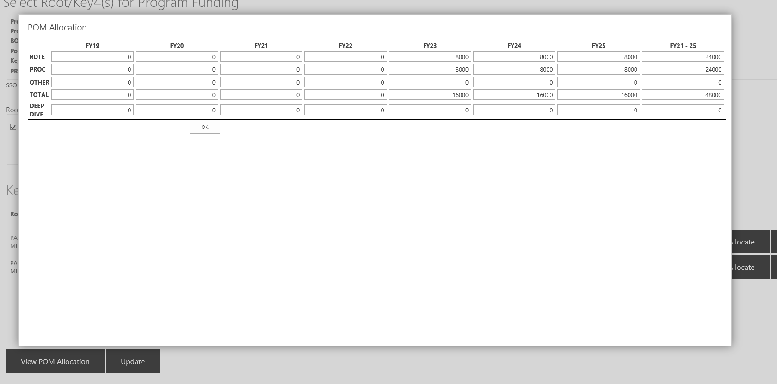
PROGRAM COLLABORATION
POM Allocation Modal Appears

Slide 46
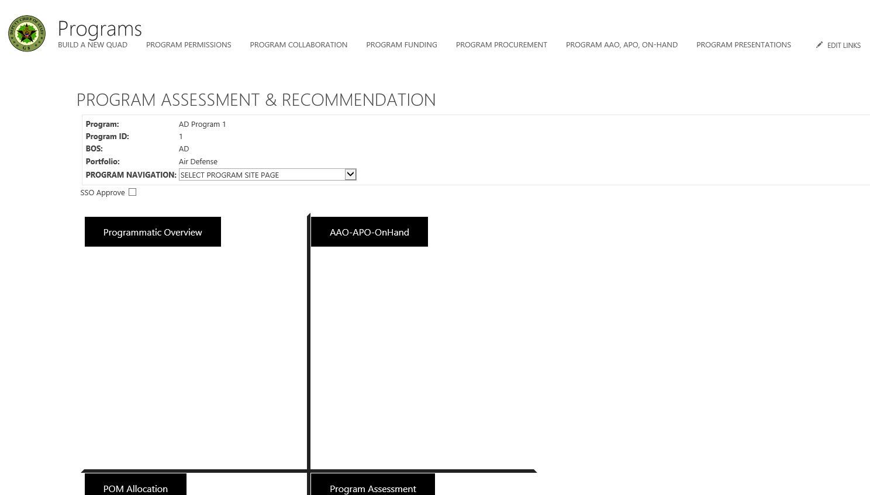
PROGRAM FUNDING
Click ‘PROGRAM FUNDING’

Slide 47
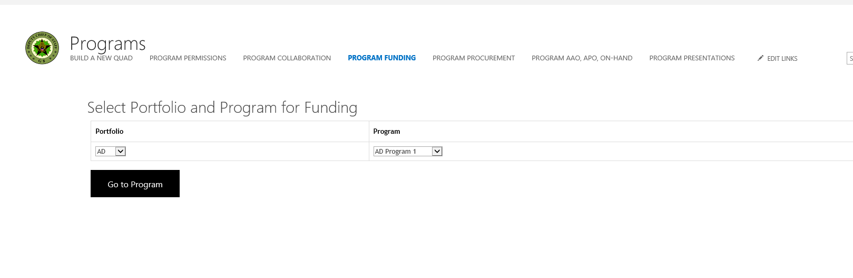
PROGRAM FUNDING
Users Redirect to Funding Page. Select BOS and Program and click ‘Go to Program’ button

Slide 48
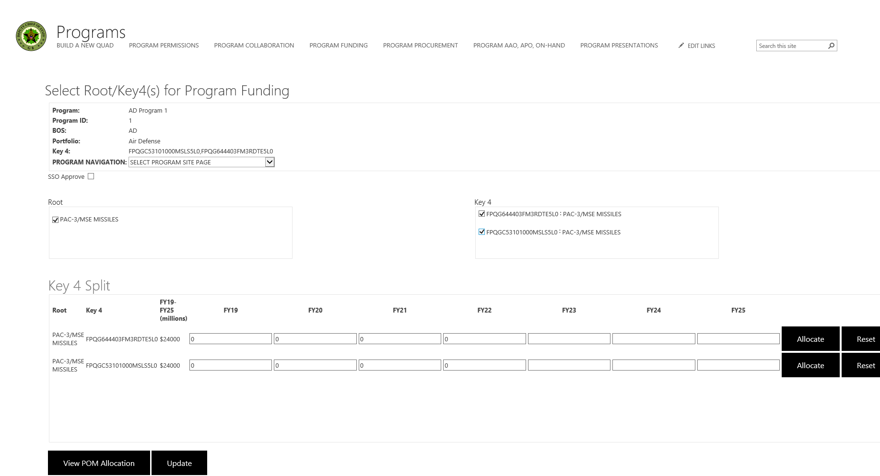
PROGRAM FUNDING
Select Root

Slide 49
PROGRAM FUNDING
Key4s Display on Key4 Surface Panel

Slide 50
PROGRAM FUNDING
Select Key 4

Slide 51
PROGRAM COLLABORATION
Key 4 FY information appears on Key 4 Split surface

Slide 52
PROGRAM FUNDING
Click View POM Allocation Button

Slide 53
PROGRAM FUNDING
POM Allocation Modal Appears

Slide 54
PROGRAM FUNDING
FY19-25(millions) will change as well as dollar values in 'View POM Allocation' modal box

Slide 55
PROGRAM FUNDING
Click Reset Button. FY19-25(millions) will reset as well as dollar values in 'View POM Allocation' modal box

Slide 56
PROGRAM FUNDING
Click Update

Slide 57
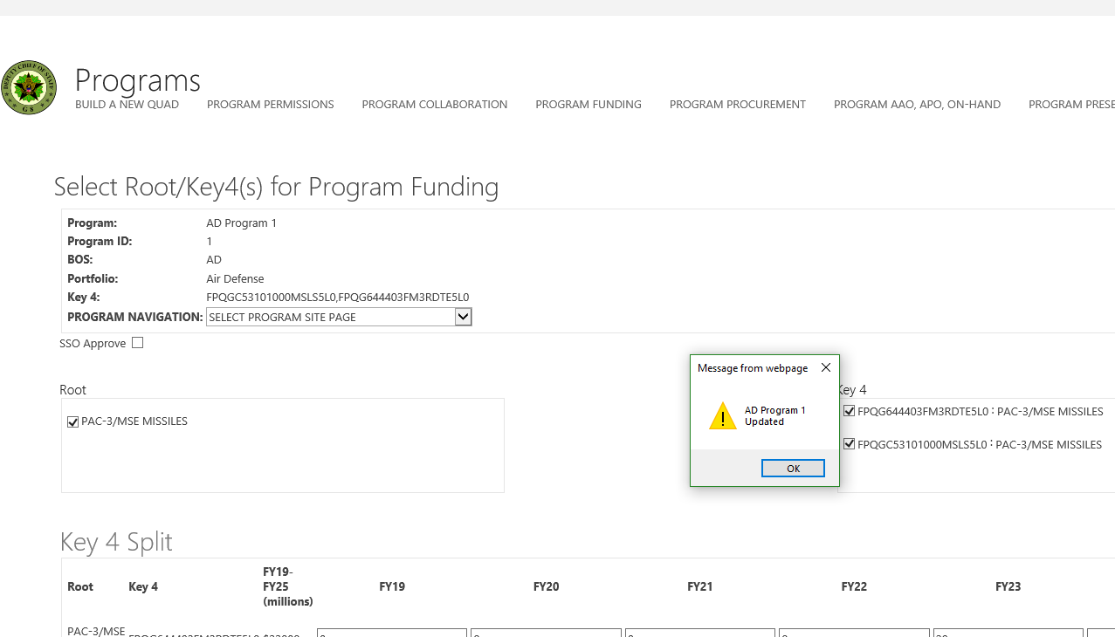
PROGRAM FUNDING
Click Update. Program Updated Message Box Appears

Slide 58
PROGRAM PROCUREMENT QUANTITIES
Click ‘PROGRAM PROCUREMENT’

Slide 59
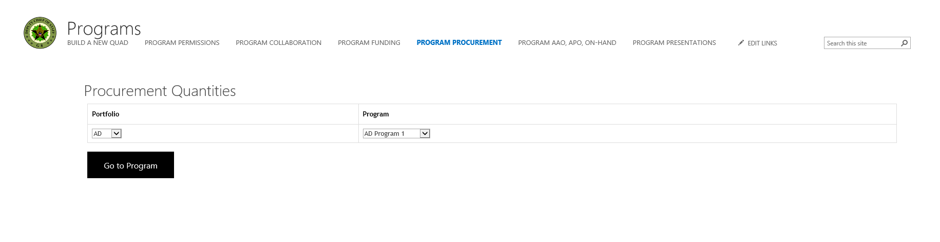
PROGRAM PROCUREMENT QUANTITIES
Select BOS & Program. Click Go to Program

Slide 60
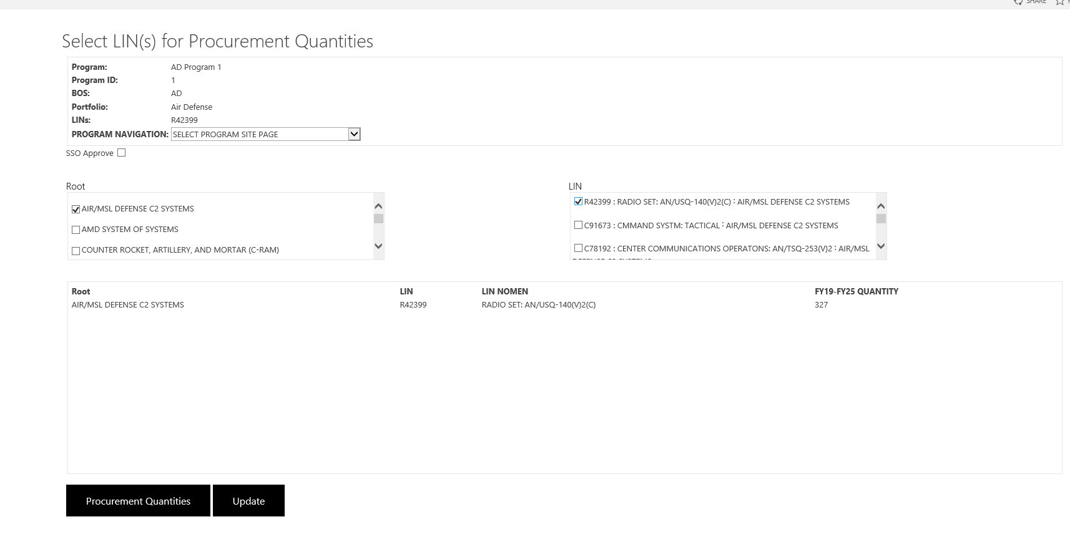
PROGRAM PROCUREMENT QUANTITIES
Select Root. LINs Display on LIN Surface Panel

Slide 61
PROGRAM PROCUREMENT QUANTITIES
Select LIN. LIN information appear on LIN allocation surface panel

Slide 62
PROGRAM PROCUREMENT QUANTITIES
Click Procurement Quantities Button

Slide 63
PROGRAM PROCUREMENT QUANTITIES
Click Update. Program Updated Message Box Appears

Slide 64
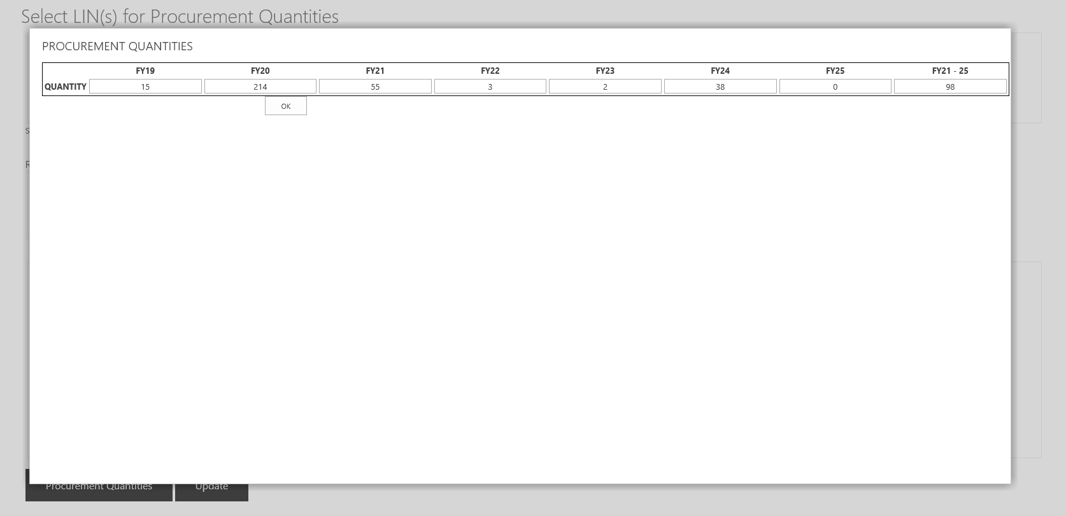
PROGRAM PROCUREMENT QUANTITIES
LIN Allocation Modal Box Appears

Slide 65
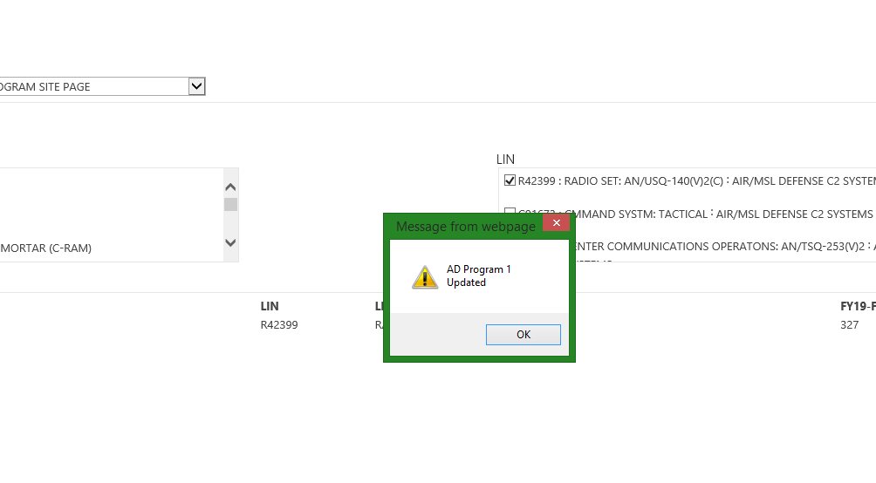
PROGRAM PROCUREMENT QUANTITIES
Click Update. Program Updated Message Box Appears

Slide 66
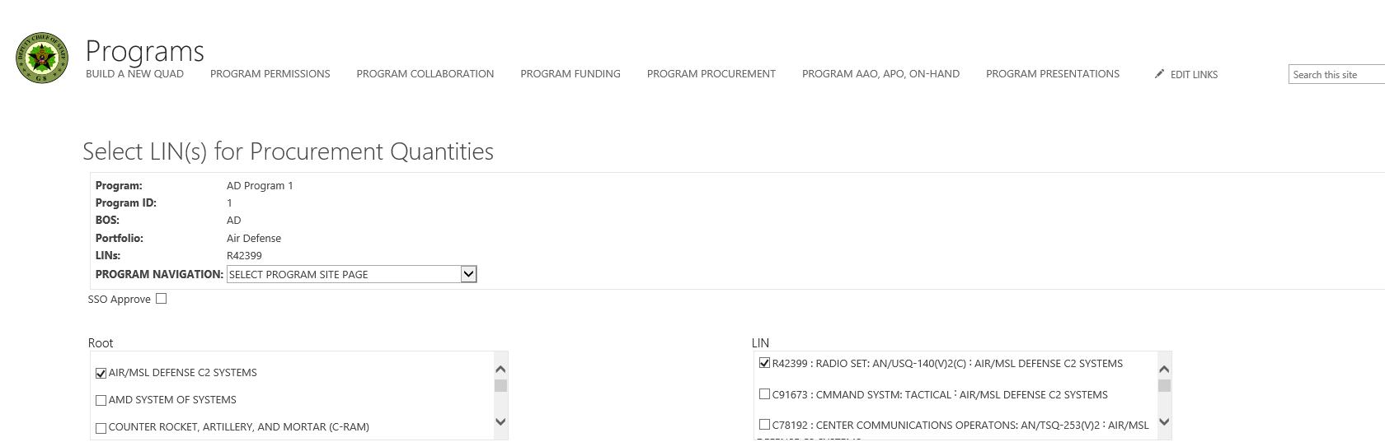
PROGRAM PROCUREMENT QUANTITIES
Click Program Presentations

Slide 67
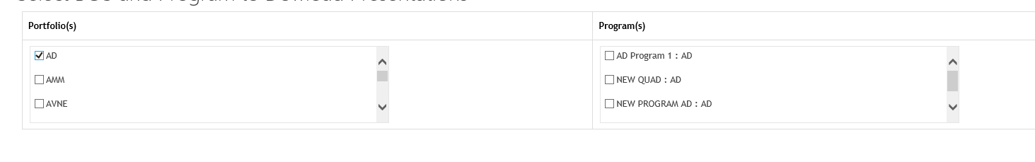
PROGRAM PRESENTATIONS
CLICK BOS/PORTFOLIO CHECK BOX. LIST OF PROGRAMS APPEAR ON PROGRAM TEXTBOX

Slide 68
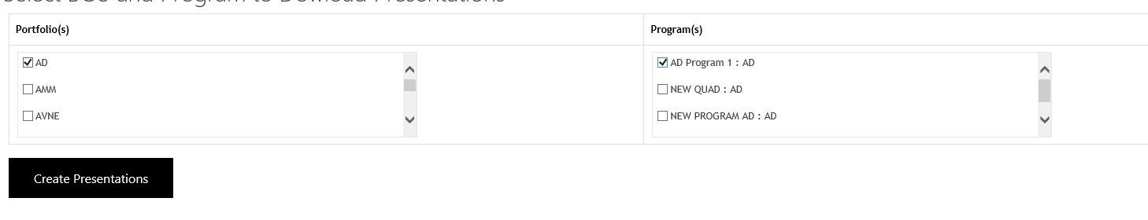
PROGRAM PRESENTATIONS
CLICK ANY PROGRAM TEXTBOX . CREATE PRESENTATIONS BUTTON APPEAR

Slide 69
PROGRAM PRESENTATIONS
CLICK CREATE PRESENTATIONS.

Slide 70
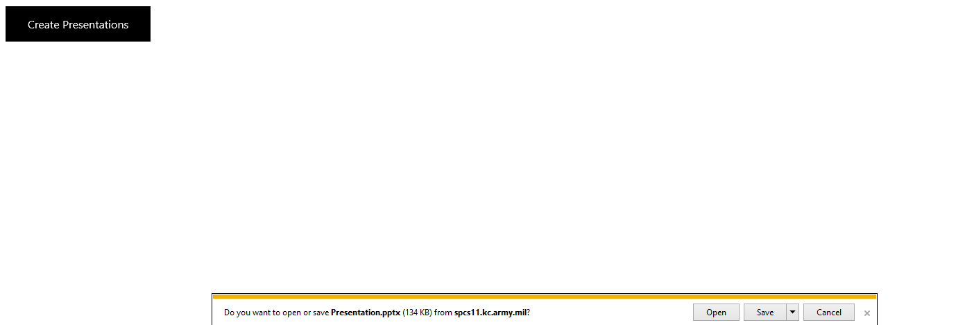
PROGRAM PRESENTATIONS
OPEN OR SAVE PRESENTATION. PRESENTATION EITHER OPENS OR DOWNLOADS TO YOUR COMPUTER

Slide 71
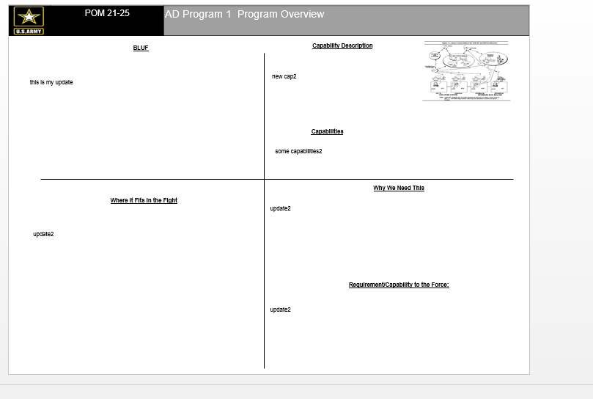
PROGRAM PRESENTATIONS
VIEW PRESENTATIONS. PROGRAM OVERVIEW

Slide 72
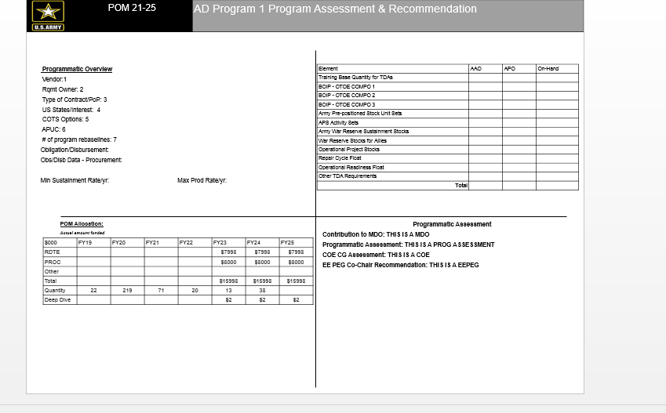
PROGRAM PRESENTATIONS
VIEW PRESENTATIONS.
PROGRAM ASSESSMENT & RECOMMENDATION

